Slide 1
CFARS 2019 Q2 European Update
(Consortium for Advancement of Remote Sensing)
Philippe Coulombe-Pontbriand
CFARS 25th of June 2019

Slide 2
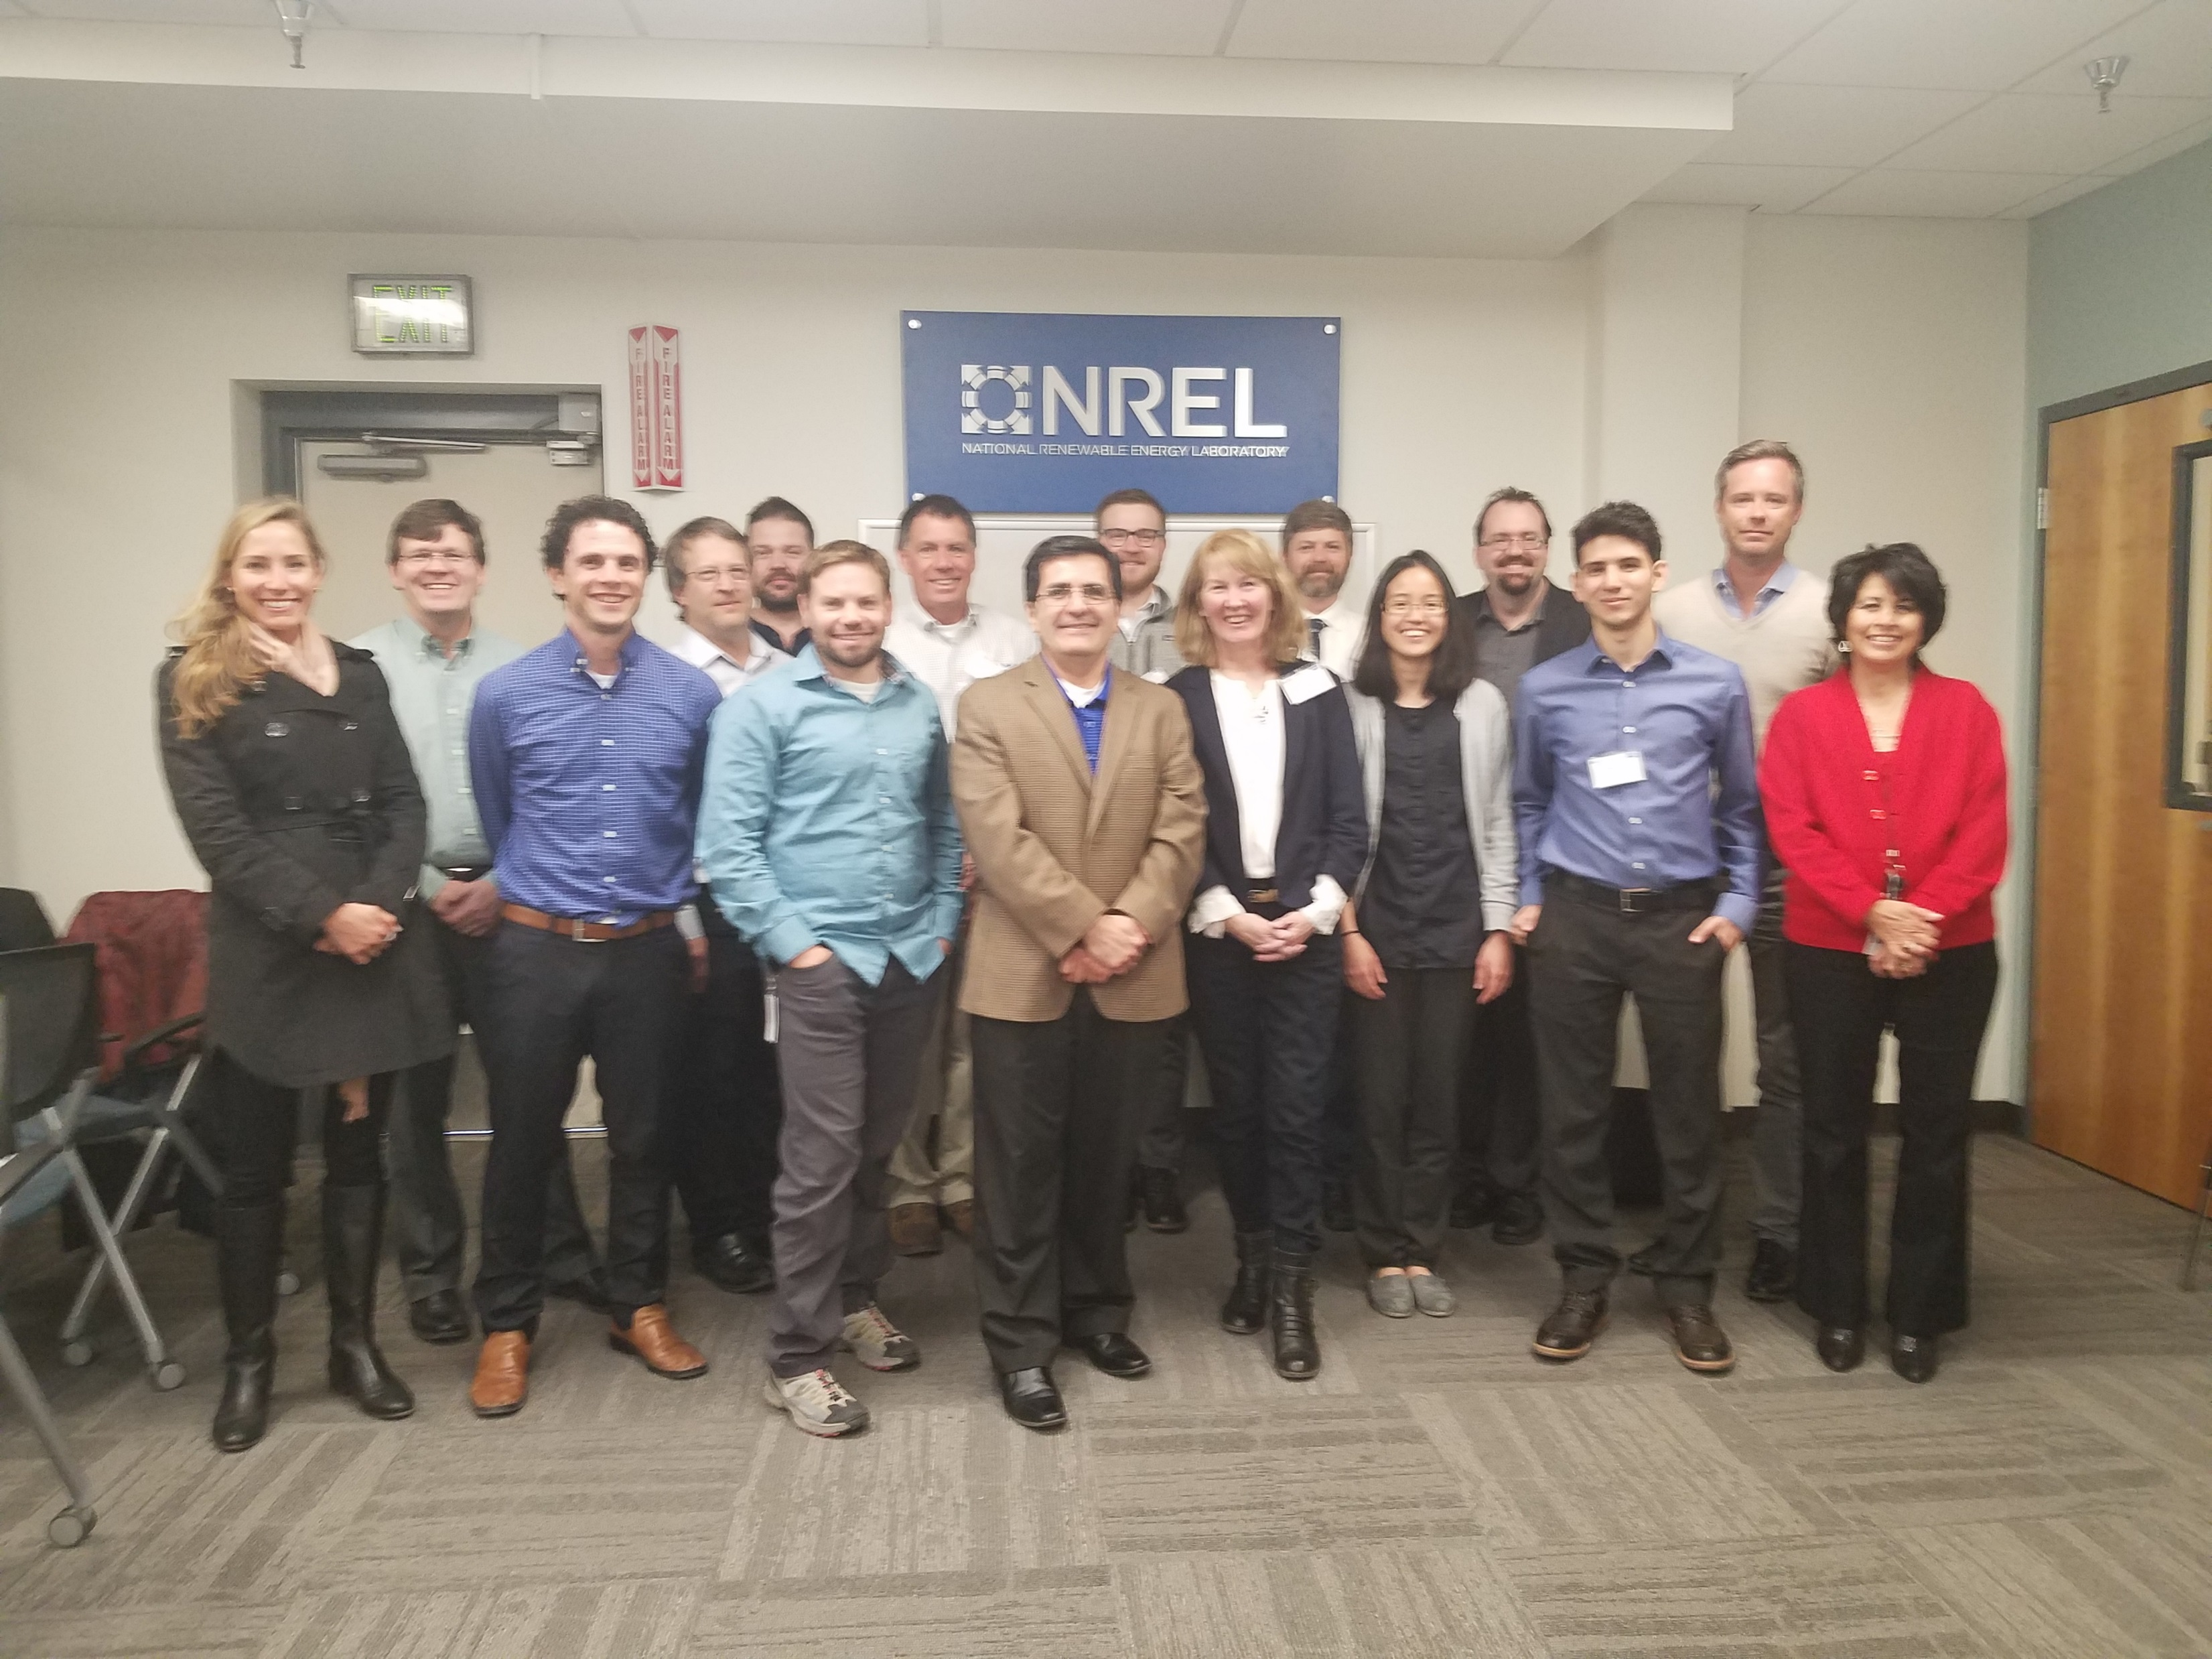
Agenda
CFARS Overview and 2018
summary
Mission, Vision and Values
2021 Horizon
2018 Key Accomplishments
Working Groups
Next Meetings

Slide 3
Objectives
Bring all of you up to speed
with CFARS activities
Clearly define 2019
roadmap
Close 2018 activities

Slide 4
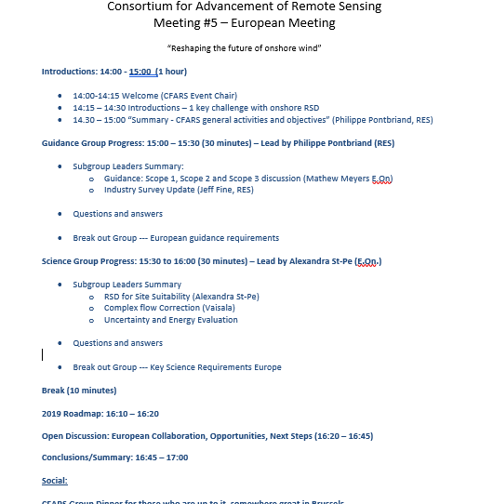

Slide 5
CFARS : Afternoon Sessions
Afternoon session: 13:30 – 16:30 (Moderated by Philippe Pontbriand)
13:30 - 14:15 2019 Roadmap definition – Presentation from sub-groups
14:30 – 15:30: CFARS presentations
H&S and measurement campaign (Aaron Waldman, RES)
Turbulence and RSD (Alex St.Pe. E.On.)
Vaisala Vector Averaging Follow up
15:30 to 16:30: Survey Feedback and Wrap up
16:30 – 17:00 Next Meeting

Slide 6
CFARS - Overview
_{Who}
_{Why}
_{How}
2017-18 members:
Major North American wind project owners, developers, operators, 3rd consultants, OEM and tech providers
Industry RSD facilitor:
Working group enabling collaboration on projects promoting the acceptance and standardization of Remote Sensing use.
Private industry players:
Private players supporting the different groups working on remote sensing use acceptance and standardization.
Create consensus:
Seek industry consensus around the use of RS. Speak with a common voice.
Build bridges:
Build bridges between industry players, research centers, standardization body and tasks. Support IEC 61400-15 working group.
Rapidly address private industry RS needs :
Steer short term projects aimed at supporting private industry needs
Access to information
Give access to a large pool of industry RS data from private sector.
Support RS validation projects
Join members' resources to support short term practical projects validating use of RS
Jointly present results
Present compelling results to banks (tax equity), the broad industry and other stakeholders
Notes:
Explain the consortium. The have people involved stand up.

Slide 7
CFARS Mission – Vision - Values
Mission
Vision
Increase acceptance of Remote Sensing Device (RSD) by sharing information and involving the broad industry
Reduce project development costs by supporting/enabling standardization and acceptance of RSD
Reduce uncertainty of pre-construction estimates by demonstrating and leveraging the value of RSD
Significantly contribute to the competitiveness of the wind industry by 2021 through broader acceptance/validation of RSD
Values
Open
Collaborative
LOW ENTRY BARRIER
INFORMATION SHARING
INCLUDE MEMBERS FROM ALL HORIZON
SHARE BEST PRACTICES
SOCIALIZE FINDINGS
Results Driven
Leadership
CLEAR GOALS
SHORT TERM GOALS
UNITED MESSAGE
SUBGROUP CHAMPIONS

Slide 8
CFARS – The 2021 Horizon
Science
Improve acceptance RSD via science
Evaluation of Industry Status
Short Term - Q1/2 - 2019
Long Term - Q1 - 2021
Medium Term - Q2/3 - 2020
Final State - Q4 - 2021
Guidance
Improve acceptance of RSD via guidance
Acceptance Criteria
Evaluate acceptance
criteria

Slide 9
CFARS 2018 Roadmap - Achievements
December 2017 January 2018 May 2018 August 2018 December 2018
Official expression of interest by members | First meeting - Working groups | Second meeting groups update | AWEA Gen. meeting | Summary of act. and 2019 RM
Proposed milestone | Description
Official expression of interest by members | Seek formal expression of interest by members Get commitment from members to make the consortium a success Get commitment to take part in the consortium meeting
First official consortium meeting | Presentation of the official members Creation of the working groups (Guidance, Science) and assignment of group leads
Second consortium meeting | Presentation of advancement of projects by the working groups Preparation for broader diffusion of outcome (AWEA, etc)
AWEA preparation | Support AWEA in preparation of a panel on remote sensing Discuss how to present consortium to a broader audience

Slide 10
CFARS Working Groups
Guidance
Working Group
CFARS
Consortium For Advancement Remote Sensing
Science
Working Group

Slide 11
CFARS Working Groups
Leadership
Group
Guidance
Working Group
CFARS
Consortium For Advancement Remote Sensing
Science
Working Group

Slide 12
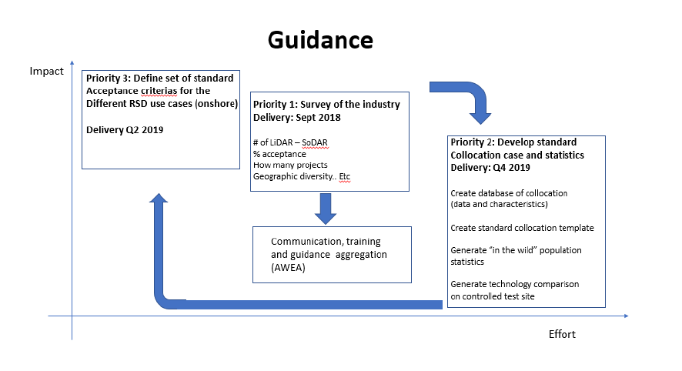
2018-2021 CFARS General Roadmap - Guidance
2019

Slide 13
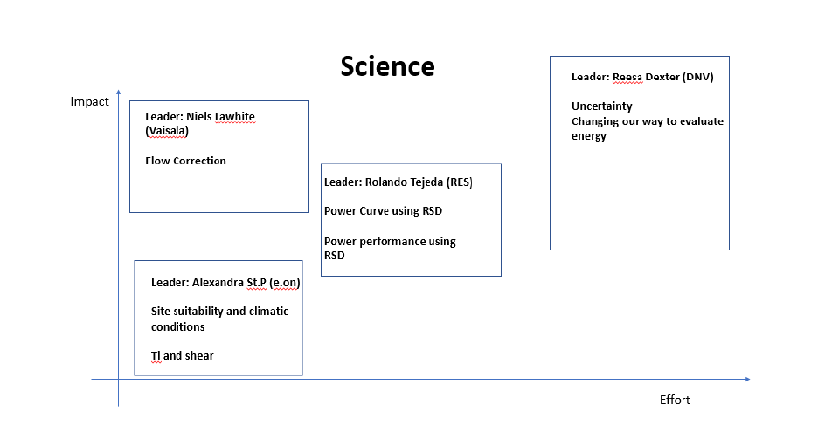
2018-2021 CFARS General Roadmap - Guidance

Slide 14
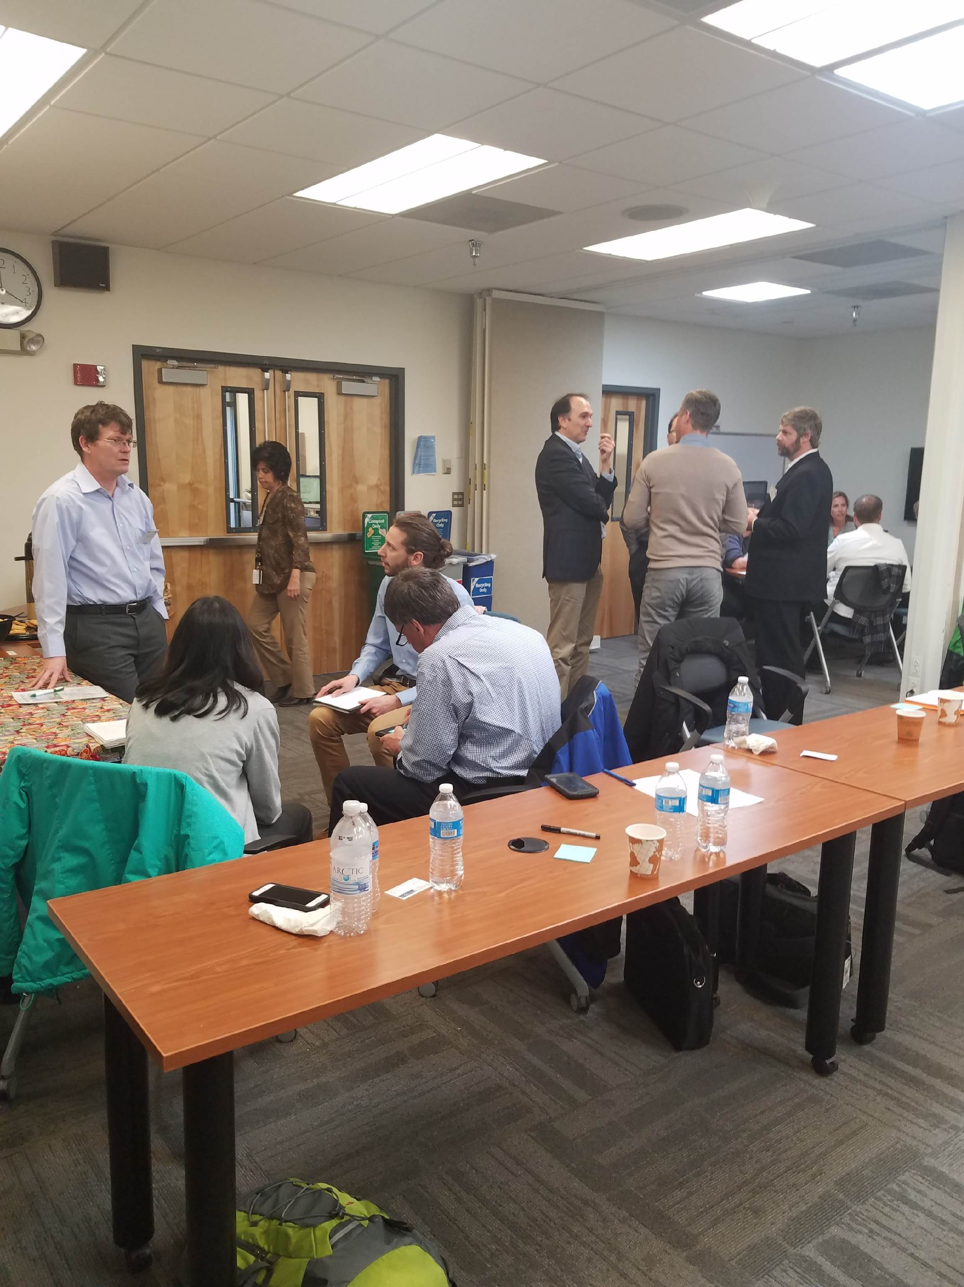
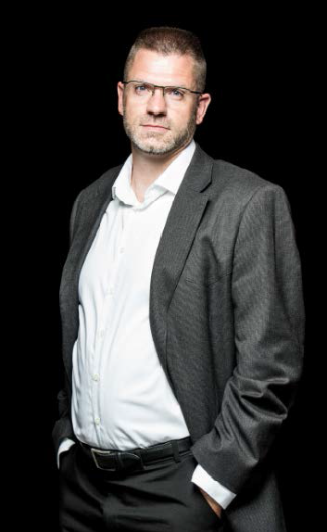
CFARS Guidance Working Group – Matthew Meyers E.ON
CFARS
Guidance
Working Group
Increase Acceptance of RSDs
Scope 1
Baseline
Scope 3
Acceptance
Criteria
Scope 2
Colocation
Validation
Mission:
Provide Data-Driven Recommendations on RSD Standardization and Acceptance
Matthew Meyers – Group Lead

Slide 15
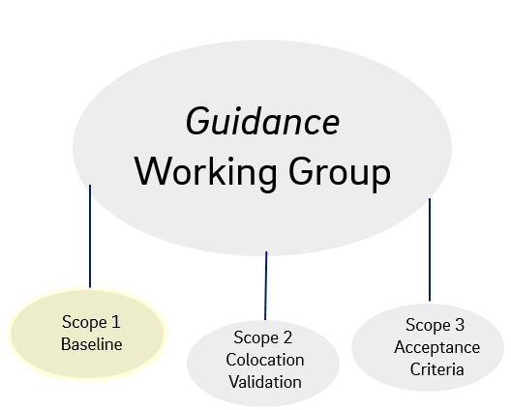
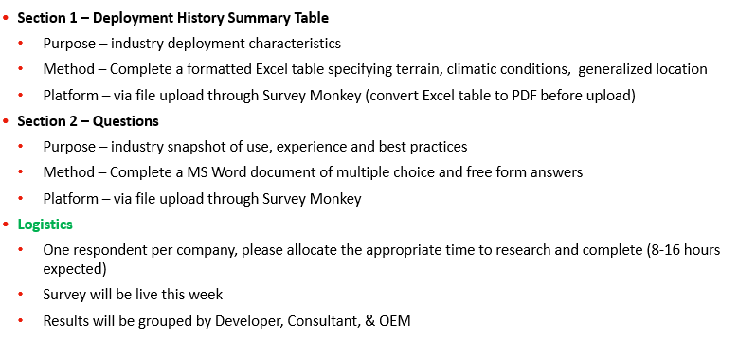
CFARS Guidance – Scope 1 Baseline – Jeff Fine – RES-Group
Mission:
Summarize current state of the North-American RSD industry by end of Q2-2019
Inform science and Scope 2-3 Guidance group
Roadmap & Next Steps:
Survey
Centralize Public
Docs.
Centralize ‘in house’
Best Practices
Inform Science and Guidance Scope 2-3
(Q1 ’19)
(Q2 ’19)
(Q2 ’19)
(Q2 ’19)
Key Accomplishments:
Survey group formed
Met 5 times
Broad range of participants
Survey form ready and released
Survey data beign compiled
SURVEY

Slide 16
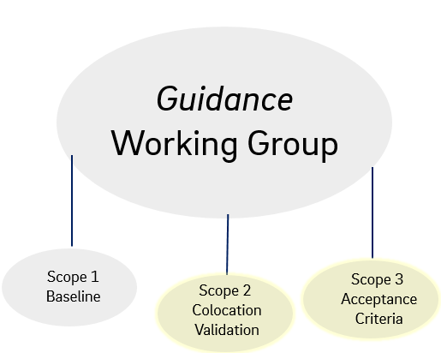
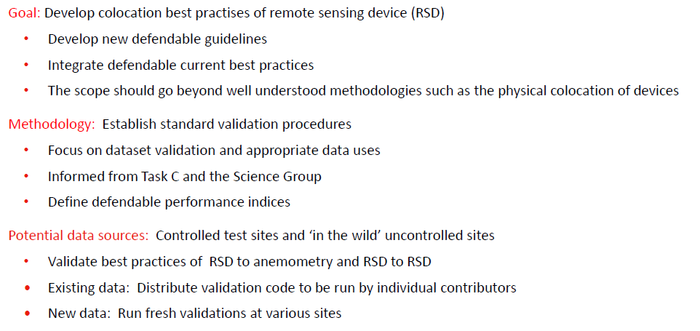
CFARS Guidance – Scope 2-3 Reesa Dexter DNV-GL / Matthew Meyers E.ON
Mission:
Scope 2: Collaborate to provide data driven colocation validation best practices
Scope 3: Collaborate to develop data driven consensus acceptance criteria
Scope Definition:
Scope 2: Colocation Validation
Scope 3: Acceptance Criteria
SUBGROUP
TO BE FORMED IN 2019
Roadmap & Next Steps:
Gather Colocation
Dataset
Results Validation
Results Publication
Inform Science and Guidance Scope 3
(Q2 ’19)
(Q2 20’)
(Q3 ’20)
(Q3 ’20)

Slide 17
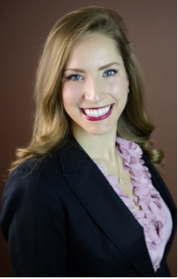
CFARS Science Working Group – Alexandra St. Pé E.ON
CFARS
Science
Working Group
Increase Acceptance of RSDs
Flow
Correction
Power
Curves
Energy
Uncertainty
Site
suitability
Mission:
Provide Data-Driven Answers to Key RSD Science Questions
Alexandra St. Pé – Group Lead

Slide 18
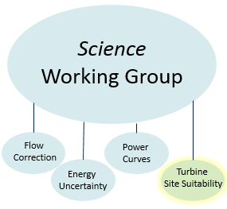
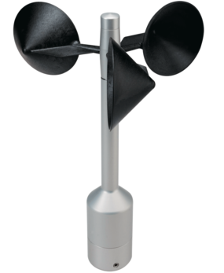
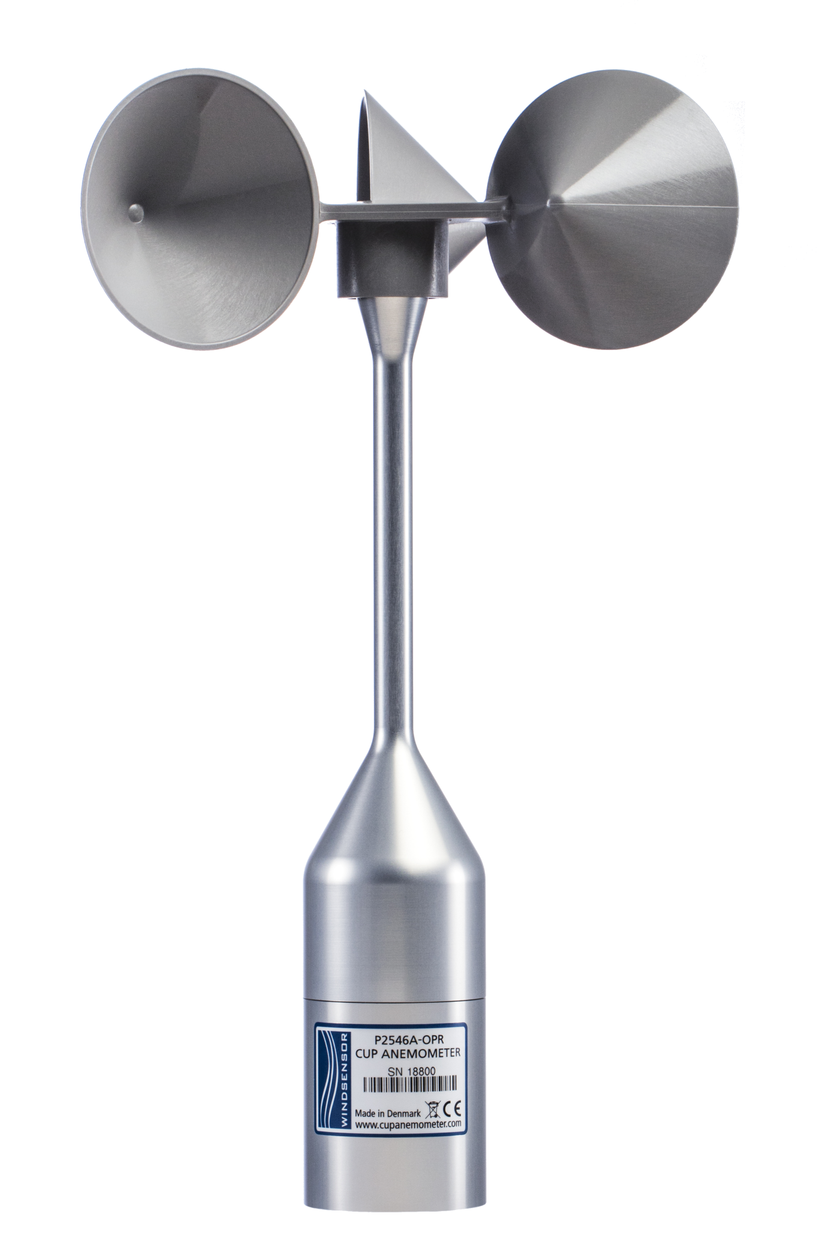
CFARS Site Suitability – Alexandra St. Pé – E.ON
Mission:
Provide data-driven answers to key RSD site suitability science questions
Brainstorm and work towards solutions to hurdles that hinder the acceptance of RSD use for site suitability assessment
Key Accomplishments:
‘Scope 1’ Research Questions & Methods for Tests Defined:
Phase 1 Tests: Is the average TI bias between a corrected RSD and reference anemometer similar to the average TI bias between a reference anemometer and different anemometer?
Phase 2 Tests: What are the most accurate & precise “in-house” RSD TI correction methods?
&
vs.
&
Corrected RSD TI
Reference Anemometer TI
Reference Anemometer TI
Anemometer 2
&
Corrected RSD TI
Reference
Anemometer TI
High Precision & High Accuracy
Roadmap & Next Steps:
Dataset Preparation Complete
Phase 1 Tests
Complete
Phase 2 Tests
Complete
Develop & Align on Best Practice RSD TI Correction Methods
(Q3 ’18)
(Q4 ’18)
(Q3 ’19)
(Q1 ’20)

Slide 19
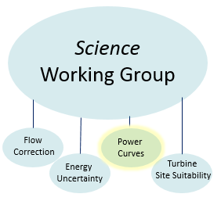
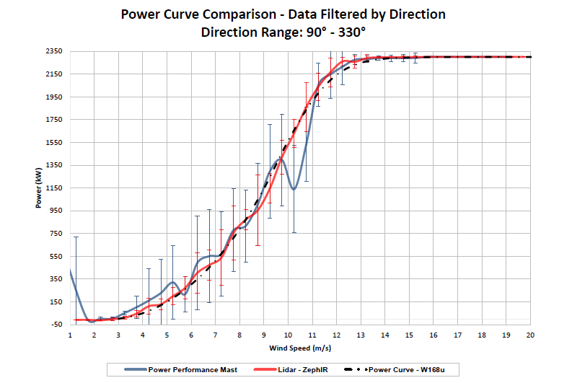
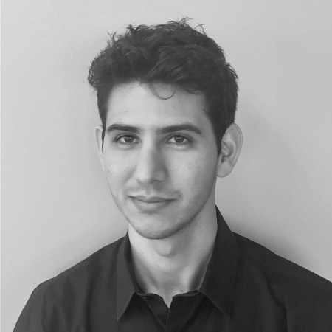
CFARS Science – Power Curve – Rolando Tejeda – RES-Group
Mission:
Provide data-driven performance validation of RSD use for Power Curve Testing
A platform for the industry to brainstorm on performance of RSD for power curve testing
Provide data to support the IEC 61400 – 12 -1 Edition 2
Key Accomplishments:
Power Curve Performance Test with SODAR, LiDAR, and Anemometer: A Comparison Study.
Wednesday, September 12, 2018: 1:30 PM - 3:00 PM
=
Roadmap & Next Steps:
Present early results AWEA 2018
Phase 1 Get the working group to replicate
Phase 2 Tests
Complete
Present the Results of a Broad Pool of Tests
(Q3 ’18)
(Q2 ’19)
(Q3 ’19)
(Q4 ’19)

Slide 20
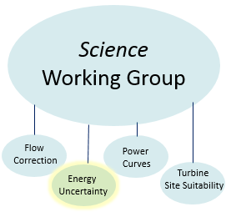
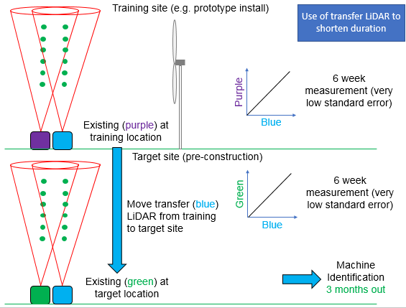
CFARS Science – Uncertainty – Philippe Pontbriand RES-Group – Reesa Dexter DNV-GL
Mission:
Improve RSD acceptance through better understanding and ideally reducing uncertainty associated to the use of RSD in pre-construction estimates
Key Accomplishments:
Concept Presentation – Calibrate to Power
- Initial concept developed by Peter Stuart RES- Group, Andy Clifton, Matt Smith ZephIR
- Plan to hold a brainstorming session on the topic with Europe, Offshore industry and the major players
RSD
RSD

Slide 21
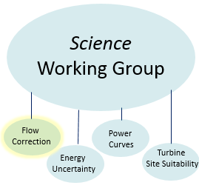
CFARS Science – Complex Flow – Paul M. – Vaisala
Mission:
Provide data-driven validation of methods used to correct RSD measurement in complex flow
Improve acceptance of RSD use in complex flow by 2021
Scope Definition:
Show typical flow curvature bias based on terrain complexity and roughness
Validate commercially available bias correction methods
Evaluate correction uncertainty as a function of site and measurement height
Demonstrate the value in correcting RSD measurements
Project kick-off in Q4 2018 (October)
Roadmap will be decided based on survey results
Validation study, uncertainty analysis, comparison of commercial correction offerings, or white paper on theory with terrain type / bias classification.
Actively seeking members – please contact Niels.LaWhite@Vaisala.com

Slide 22
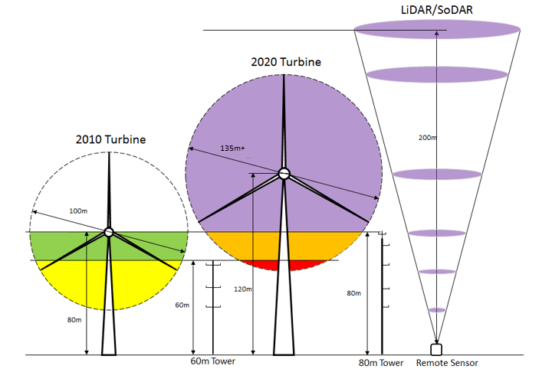
Next Meeting
2019 Q2 – In Europe!
Think about this…

Slide 23
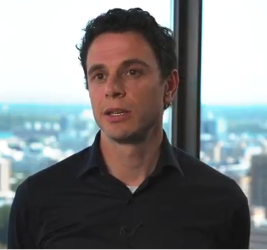
Get Involved!
General CFARS Topics
Philippe Coulombe-Pontbriand
Philippe.Pontbriand@res-group.com
CFARS Science Group
Alexandra St. Pé
alexandra.st.-pe@eon.com
CFARS Guidance Group
Matthew Meyers
matthew.meyers@eon.com

